Slide 3
MongoDB 3.2
Your Name
Your MUG

Slide 4
Themes

Slide 5



Themes
More use cases. Pluggable storage engines enables you to use MongoDB in more projects with the same core database.
Mission-critical apps. MongoDB delivers major advances in the critical areas of governance, high availability, and disaster recovery.
New tools for new users. Now MongoDB is an integral part of the tooling and workflows of Data Analysts, DBAs, and Operations teams.

Slide 6
Storage Engines
Notes:
Now let’s take a deep dive into the Storage Engines and how they can help you use MongoDB for a wide array of new projects. With this release you get a lot more choice with your storage engines. You can mix and match multiple storage engines within a deployment to bring a new level of optimization to your applications.
Let’s take a look so you can see which is right for you.

Slide 7
WiredTiger is the Default
What you get
Best general-purpose storage engine
7-10x better throughput
Up to 80% compression
“Out of the box”
No special configuration needed
Notes:
WiredTiger was available as an alternative to the MMAP Storage Engine, which was the default storage engine in previous to MongoDB 3.0.
WiredTiger offers a lot of benefits to MongoDB users. WiredTiger has granular concurrency control and native compression, giving you better storage efficiency and higher performance for a broad range of apps.
Now it is the default storage engine in MongoDB 3.2, so no need to do any special configuration to get these benefits.

Slide 8
In-Memory Storage (In Beta)
What you get
Delivers highly predictable throughput and latency for the most demanding workloads
In-memory computing without trading away guarantees of disk-based databases like
Rich query flexibility
Real-time analytics
Scalable capacity
Durability
Durability via replica set members running disk-backed storage engine
Notes:
In-memory computing is known to be much faster, and it enables data access and analytics at speeds never before possible. However, in the past, memory costs were prohibitive. Now, that the cost of memory has gone down, and will continue to tumble, you can take advantage of these performance gains.

Slide 9
Encrypted Storage
What you get
End-to-end encryption of sensitive data for regulated industries
Durability via replica set members running disk-backed storage engine
Beta testers observed an average 15% overhead – lower than many 3rd party encryption solutions
Visit the documentation for information on configuration
Note
Based on the WiredTiger Storage Engine
Available in MongoDB Enterprise Advanced
Notes:
Encrypted Storage engine is the name of the feature but is NOT separate from WT, rather an option -- want to avoid any chance of confusion!
KMIP is a popular standard that we plan to support; SafeNet and Vormetric are good examples, as is Amazon’s KMS

Slide 10
Storage Engines
Notes:
Now let’s take a deep dive into the Storage Engines and how they can help you use MongoDB for a wide array of new projects. With this release you get a lot more choice with your storage engines. You can mix and match multiple storage engines within a deployment to bring a new level of optimization to your applications.
Let’s take a look so you can see which is right for you.

Slide 11
Document Validation
What you get
Implement data governance without sacrificing agility that comes from dynamic schema
Enforce data quality across multiple teams and applications
Use familiar MongoDB expressions to control document structure.
More power to the DBAs
The DBA can specify which documents in a collection should be validated
Failed validations can be configured
Hard error
Just a warning
Notes:
Validation is optional, and can be as simple as a single field, all the way to every field, including existence, data types, and regular expressions.
Failed validation tests can result in a hard error or just a warning

Slide 12
Simplified Sharded Cluster Management
What you get
Simplified sharded deployments
Config servers are deployed as replica sets
Improved metadata consistency
Easily scale to many data centers
Notes:
Config server setup provides higher levels of availability and lower cross-region latency.

Slide 13
Config server replica sets can span more than 3 data centers with up to 50 replica set members supported

Slide 14
Fast Failover
The Improvements
Enhanced algorithm detects failure and isolation of primary in replica set
Reduces interval between primary failure and the replacement
Resolves false-positives caused by network glitches
Allows efficient intra-cluster communications, even as the replica set grows
What you get
No more than 2 seconds to detect and recover replica set primary failure
Exact time is dependent on system configuration
Tune the timing with the electionTimeoutMillis parameter
Clusters more resilient to overloaded or unreliable networks
Notes:
Fast Failure - in many scenarios failover will be well under 2 seconds including sub-second, but we want to set reliable expectations
The exact failover time is dependent on the system’s configuration (for example the network latency between data centers), but for a typical configuration it would be no more than 2 seconds – the user can tune this using the electionTimeoutMillis parameter.

Slide 15
New Tools for New Users

Slide 16

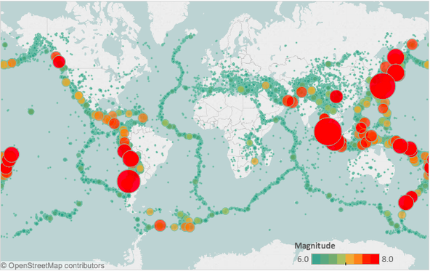
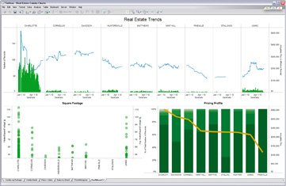
Data Analysts
BI Connector: Visualize untapped data from MongoDB using standard tools and SQL
$lookup: Join data from separate collections for more convenient analysis
Aggregation Enhancements: Faster & simpler real-time analytics with new accumulators, arithmetic & array operators
Notes:
BI Connector requires Enterprise Advanced subscription
SQL supported is read-only and covers what is required for most BI tools (we can’t simply say SQL92 b/c it only supports reads)

Slide 17

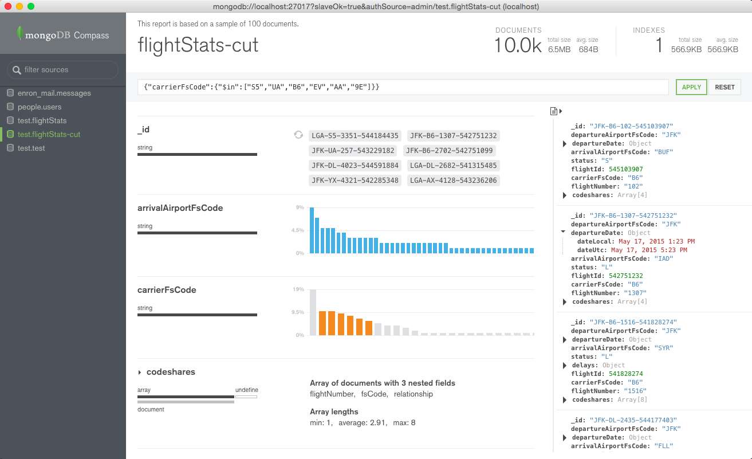
DBAs
MongoDB Compass for fast schema discovery and visual construction of ad-hoc queries
Visualize schema
Frequency of fields
Frequency of types
Determine validator rules
View Documents
Graphically build queries
Authenticated access
Notes:
MongoDB Compass requires Professional of Enterprise Advanced subscription
“Determine validator rules”: you can use the tool to figure out what you want to set as validation rules. A future version could integrate with the database to set document validation rules for a collection.

Slide 18

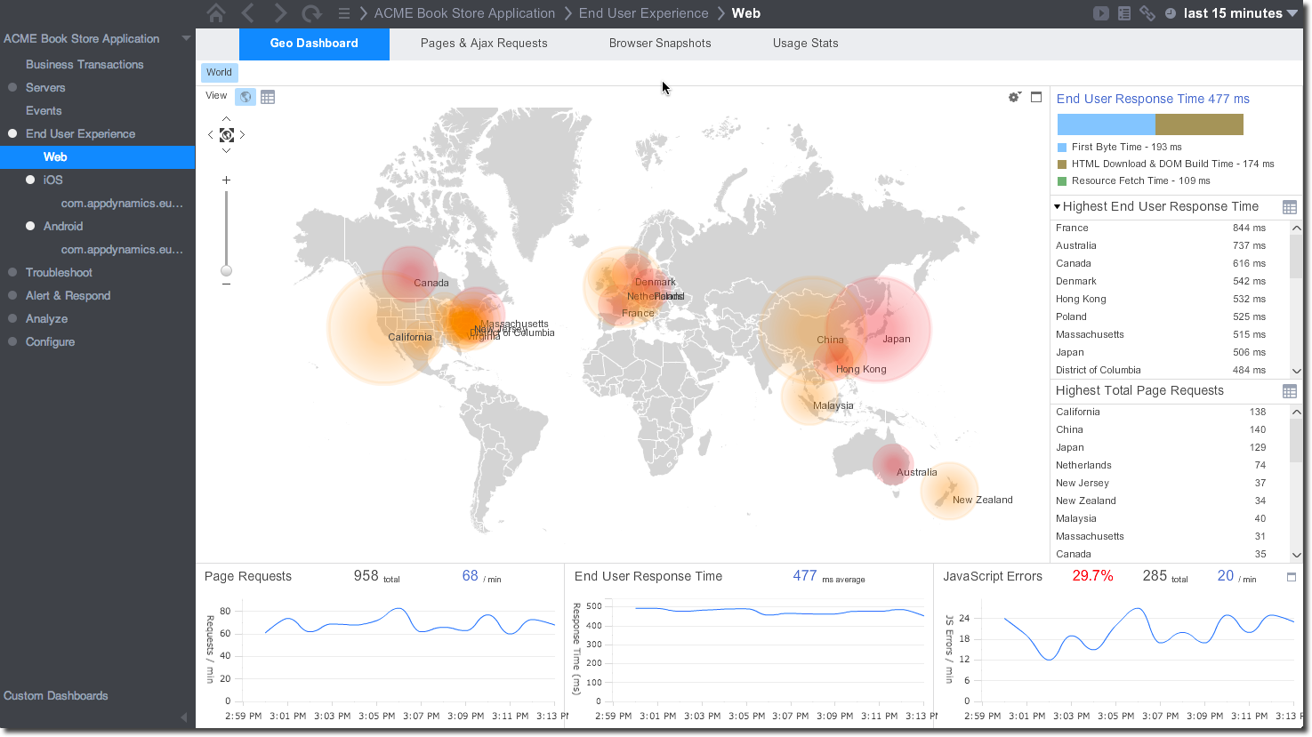
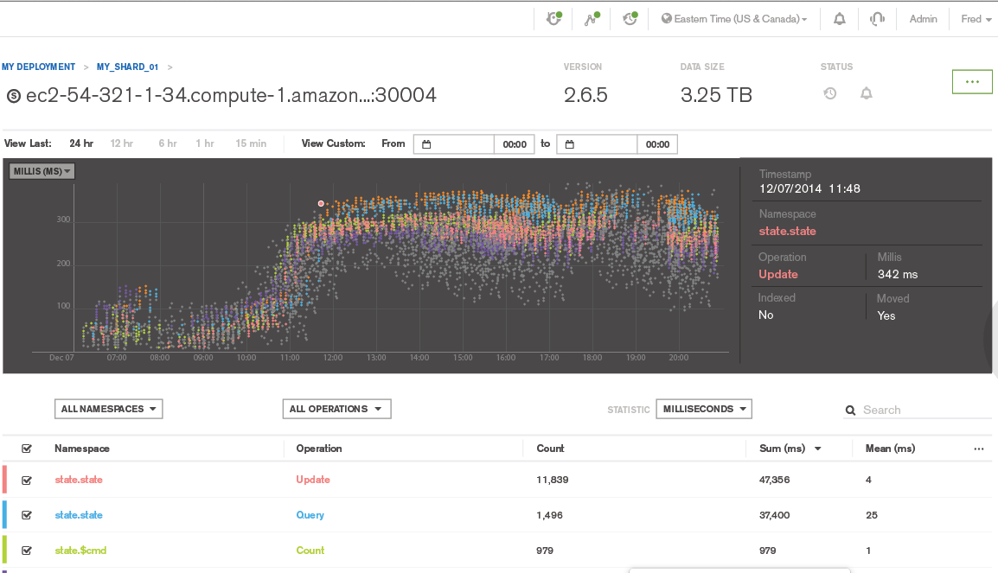
Operations
Integration with standard operational workflow reduces overhead
Start from global view of infrastructure: APM tools integration, e.g. New Relic, AppDynamics.
Then, drill down: Profiler visualization in Ops Manager
Then, deploy: Automated index builds
Next, refine: Partial Indexes improve resource utilization
Notes:
MongoDB Ops Manager and Cloud Manager is the best way to run MongoDB, reducing tasks such as deployment, scaling, upgrades and backups to just a few clicks or an API call. Operations teams can be 10-20x more productive using the Ops or Cloud Manager platforms.
With these enhancements to Ops and Cloud manager, administrators can
Integrate MongoDB alongside existing Application Performance Monitoring platforms for global health visibility over the entire IT estate, all from a single pane of glass
Drill down into any MongoDB-specific issues using Ops Manager’s monitoring of key database telemetry, including new query profiler visualizations
Create a point-in-time backups and consistent snapshots of the database on standard network-mountable filesystems
Use Ops Manager automation to initiate zero-downtime maintenance and upgrade activities, such as rolling out new indexes across a sharded cluster
Profiler Visualization: Enabling Fast and Simple Query Optimization
Automated Index Builds
New Indexing Option: Partial Indexes

Slide 19
Download Now
Community mongodb.org/downloads
Enterprise mongodb.com/lp/download/mongodb-enterprise

